Slide 1


THE ROLE OF AI CHATBOTS IN HEALTHCARE EDUCATION AND SUPPORT
Enhancing Patient Education with AI-Powered Chatbots: A Hybrid Approach to Personalized Health Communication
Created by: Tejaswi Cheekati

Slide 2
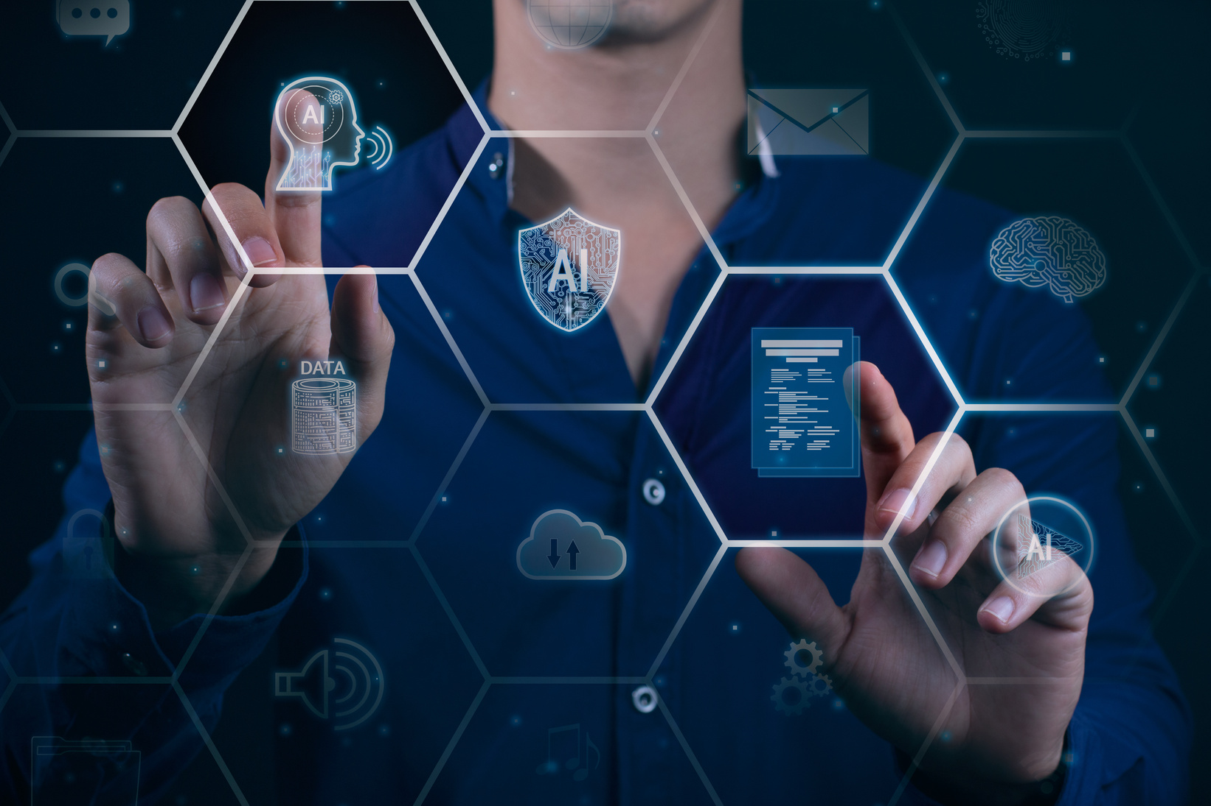
INTRODUCTION
Traditional methods of patient education are limited in personalization and scalability.
Patients often leave clinical encounters with unanswered questions.
There’s a growing demand for interactive, reliable, and accessible health information.
AI chatbots offer a dynamic solution to fill the gap in health communication.

Slide 3

PROBLEM & OBJECTIVE
Problem: Time constraints, outdated brochures, and generic web info affect patient education quality.
Objective:
Develop a hybrid AI chatbot combining ML and DL.
Provide personalized, on-demand, medically accurate patient education.
Improve health literacy and engagement across diverse populations.

Slide 4

AI TECHNOLOGIES OVERVIEW
Machine Learning (ML):
Ideal for structured data, quick classification, reminders.
Algorithms: Decision Trees, SVMs, Logistic Regression.
Deep Learning (DL):
Ideal for unstructured, emotional, contextual language.
Models: Neural Networks, LSTM, Transformers (BERT, GPT).

Slide 5

ROLE OF NLP
NLP bridges clinical language with patient understanding.
Functions:
Intent recognition
Sentiment analysis
Contextual dialogue
Enables human-like interaction and emotional sensitivity.

Slide 6
REAL-WORLD APPLICATIONS
Real-World Applications (ML)
ML-based chatbots like Florence, HealthTap:
Medication reminders
Triage and scheduling
Operate via predefined logic and structured inputs.
Fast, efficient, but limited in handling nuance or emotion.
Real-World Applications (DL)
DL-based chatbots in oncology and mental health:
Analyze patient history and ongoing feedback
Adapt to tone and phrasing (e.g., Woebot, Jungmann et al., 2023)
Provide symptom tracking, emotional support, and treatment guidance.
GPT-based bots address vaccine misinformation and complex queries.

Slide 7
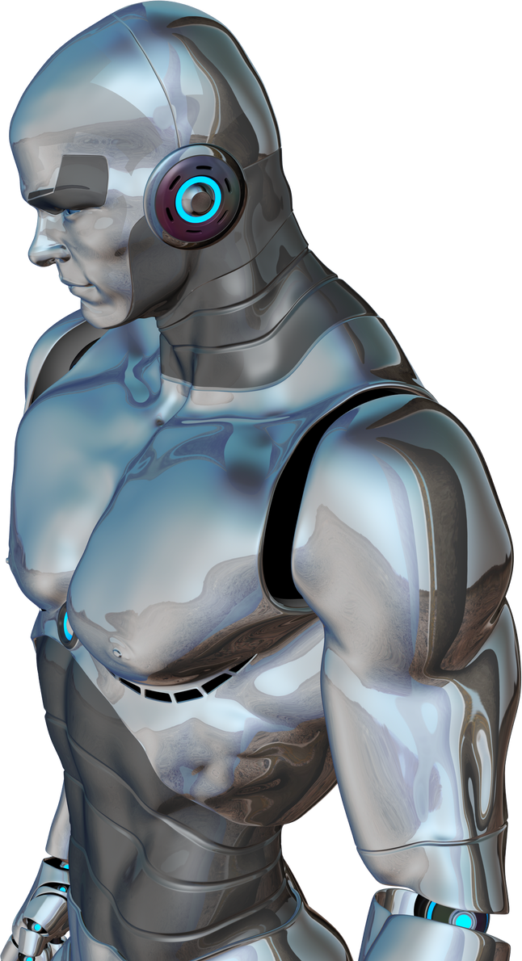
IMPLEMENTATION CHALLENGES
Data Privacy Risks:
HIPAA compliance concerns
Sensitive patient data exposure
Over-reliance:
Patients might trust chatbots over professionals
Lack of empathy:
Chatbots can't replicate human compassion fully

Slide 8
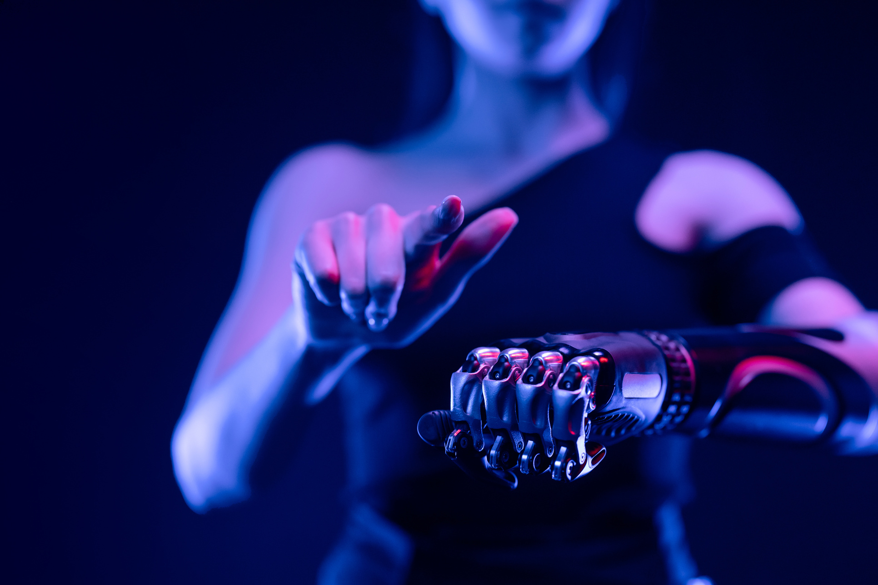
SAFEGUARDS & DESIGN ETHICS
Built-in alerts for conflicting medical advice.
Recommend follow-ups with human providers when necessary.
Controlled learning from anonymized interactions.
Regular ethical audits and safety reviews.

Slide 9
BEYOND ALGORITHMS: EMERGING AI TOOLS
Computer Vision:
Diagnose skin conditions from uploaded images
Monitor wound healing, medication usage
Robotics Integration:
Physical robots delivering care instructions in hospitals, elderly care
Intelligent Agents:
Schedule appointments, escalate emergency cases, detect confusion
NLP Advancements:
Real-time translation, emotional insight, dynamic feedback

Slide 10
HYBRID AI MODEL ARCHITECTURE
Combine strengths of ML and DL:
ML handles: Triage, classification, appointment management
DL handles: Natural conversation, personalization, emotional tone
Example Structure:
Backend: ML for structured tasks
Frontend: DL + NLP for patient dialogue
Outcome: Balance between interpretability, performance, and empathy

Slide 11
FUTURE INNOVATIONS IN AI CHATBOTS
Adaptive Learning:
Chatbot evolves through reinforcement learning based on patient feedback
Multimodal Interfaces:
Use speech, images, biometrics for richer interaction
Predictive Analytics:
Identify patients at risk of non-adherence or chronic condition flare-ups
Proactive Outreach:
Chatbot educates before symptoms worsen (preventive approach)

Slide 12
FUTURE CHALLENGES & OPPORTUNITIES
Explainable AI (XAI):
Make chatbot decisions transparent and patient-friendly
Privacy by Design:
Privacy compliance embedded at the architecture level
Cultural & Linguistic Customization:
Expand chatbot reach globally
AI Ethics Compliance:
Align with WHO and EU AI Act frameworks

Slide 13
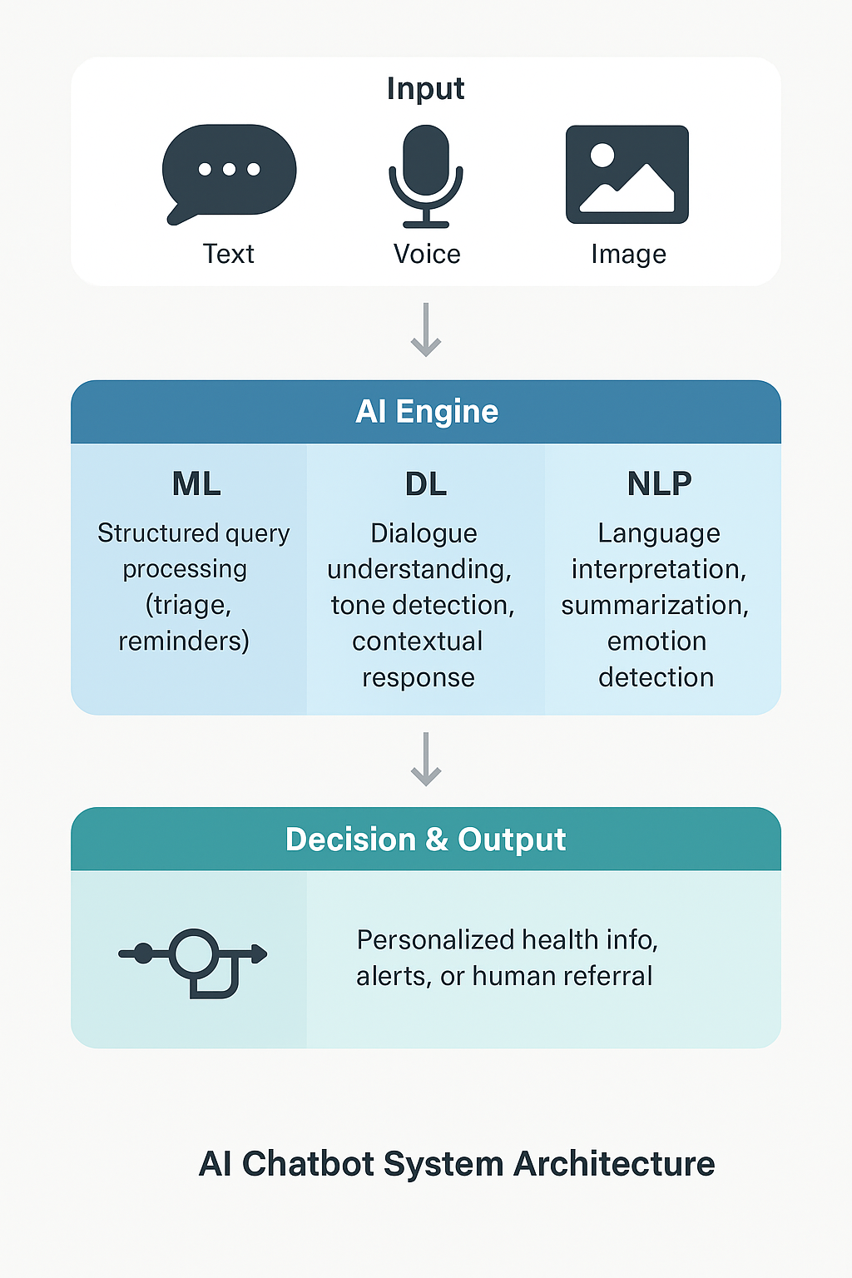
AI CHATBOT SYSTEM ARCHITECTURE

Slide 14
SUMMARY & FINAL THOUGHTS
AI-powered chatbots revolutionize patient education through:
Scalability: 24/7 availability
Personalization: Tailored education based on patient context
Interactivity: Engaging, emotionally aware conversation
Conclusion:
Hybrid chatbot systems combining ML, DL, NLP, and emerging AI offer a scalable, ethical, and empathetic solution to healthcare communication gaps
Future Promise: AI chatbots will be indispensable in preventive care and digital health transformation

Slide 15
THANK YOU!
FOR YOUR ATTENTION

